Slide 1
Longest Common Subsequence

Slide 2
Longest Common Subsequence
What is LCS?
Can we apply Dynamic Programming to solve LCS?

Slide 3
Longest Common Subsequence
Examples:
String 1: a b a c d e g j
String 2: b a d
String 1: c h o c o l a t e
String 2: c o l g a t e
String 1: a b c d e f g h i j
String 2: d a c e g i
String 1: a b d a c e
String 2: b a b c e

Slide 4
LCS using Divide and Conquer
Algorithm RLCS (i,j)
{
if(i=0 or j=0) then
return 0;
else if (a[i]=b[j]) then
return 1+RLCS(i-1,j-1);
else
return max(RLCS(i-1,j),RLCS(i,j-1));
}

Slide 5
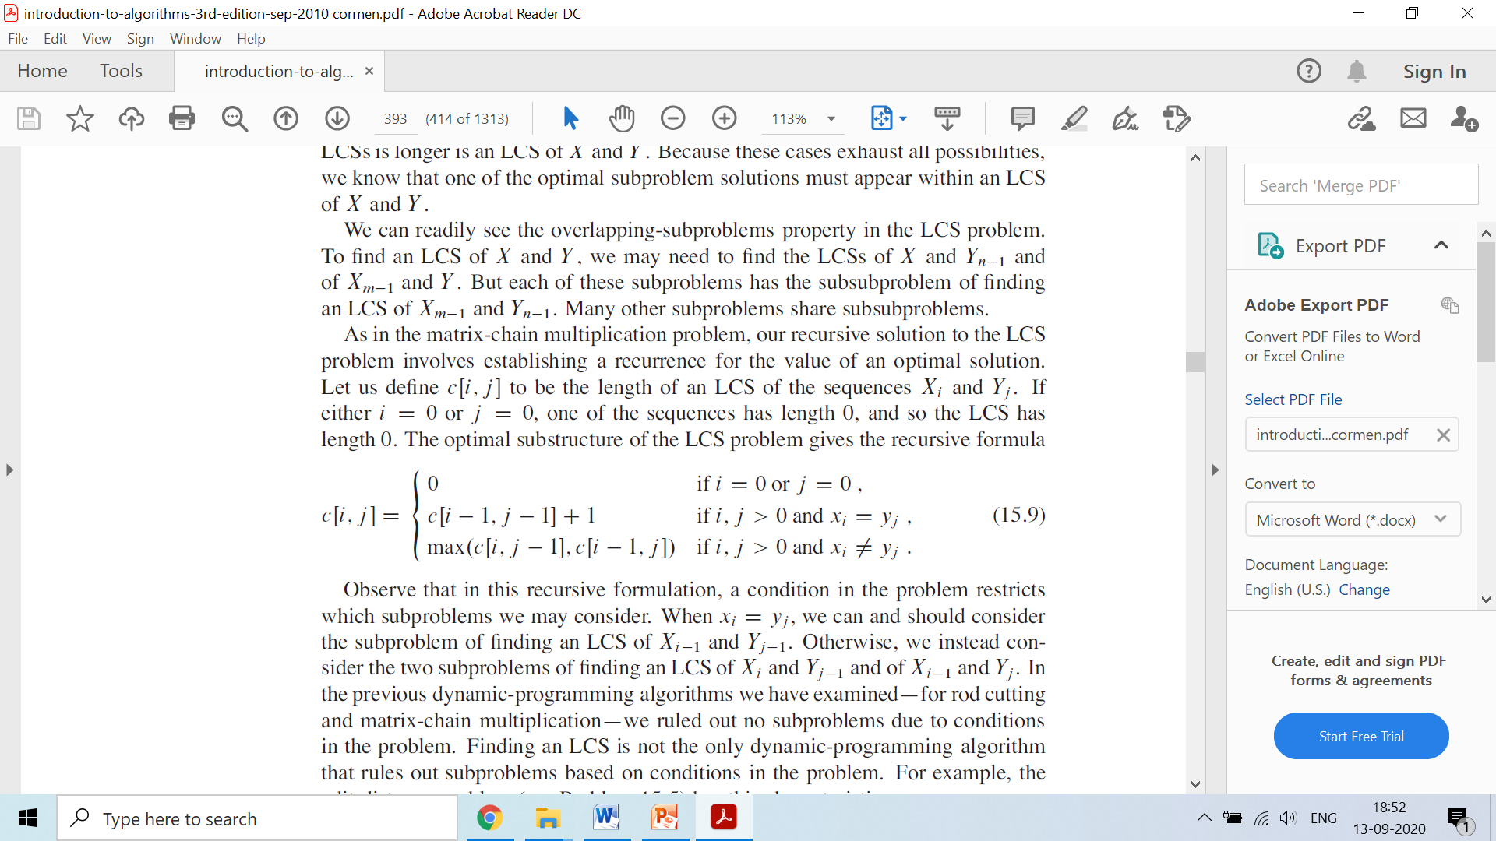
LCS using Dynamic Programming

Slide 6
 |  |  | a | b | c | d
 |  | 0 | 1 | 2 | 3 | 4
 | 0 | 0 | 0 | 0 | 0 | 0
a | 1 | 0 | 1
c | 2 | 0
d | 3 | 0
A | a | c | d
 | 1 | 2 | 3
B | a | b | c | d
 | 1 | 2 | 3 | 4
if(i=0 or j=0) then
return 0;
else if (A[i]=B[j]) then
LCS[i,j]=1+LCS[i-1,j-1];
else
LCS[i,j]=max(LCS[i-1,j],LCS[i,j-1]);

Slide 7
 |  |  | a | b | c | d
 |  | 0 | 1 | 2 | 3 | 4
 | 0 | 0 | 0 | 0 | 0 | 0
a | 1 | 0 | 1 | 1
c | 2 | 0
d | 3 | 0
A | a | c | d
 | 1 | 2 | 3
B | a | b | c | d
 | 1 | 2 | 3 | 4
if(i=0 or j=0) then
return 0;
else if (A[i]=B[j]) then
LCS[i,j]=1+LCS[i-1,j-1];
else
LCS[i,j]=max(LCS[i-1,j],LCS[i,j-1]);

Slide 8
 |  |  | a | b | c | d
 |  | 0 | 1 | 2 | 3 | 4
 | 0 | 0 | 0 | 0 | 0 | 0
a | 1 | 0 | 1 | 1 | 1
c | 2 | 0
d | 3 | 0
A | a | c | d
 | 1 | 2 | 3
B | a | b | c | d
 | 1 | 2 | 3 | 4
if(i=0 or j=0) then
return 0;
else if (A[i]=B[j]) then
LCS[i,j]=1+LCS[i-1,j-1];
else
LCS[i,j]=max(LCS[i-1,j],LCS[i,j-1]);

Slide 9
 |  |  | a | b | c | d
 |  | 0 | 1 | 2 | 3 | 4
 | 0 | 0 | 0 | 0 | 0 | 0
a | 1 | 0 | 1 | 1 | 1 | 1
c | 2 | 0
d | 3 | 0
A | a | c | d
 | 1 | 2 | 3
B | a | b | c | d
 | 1 | 2 | 3 | 4
if(i=0 or j=0) then
return 0;
else if (A[i]=B[j]) then
LCS[i,j]=1+LCS[i-1,j-1];
else
LCS[i,j]=max(LCS[i-1,j],LCS[i,j-1]);

Slide 10
 |  |  | a | b | c | d
 |  | 0 | 1 | 2 | 3 | 4
 | 0 | 0 | 0 | 0 | 0 | 0
a | 1 | 0 | 1 | 1 | 1 | 1
c | 2 | 0 | 1
d | 3 | 0
A | a | c | d
 | 1 | 2 | 3
B | a | b | c | d
 | 1 | 2 | 3 | 4
if(i=0 or j=0) then
return 0;
else if (A[i]=B[j]) then
LCS[i,j]=1+LCS[i-1,j-1];
else
LCS[i,j]=max(LCS[i-1,j],LCS[i,j-1]);

Slide 11
 |  |  | a | b | c | d
 |  | 0 | 1 | 2 | 3 | 4
 | 0 | 0 | 0 | 0 | 0 | 0
a | 1 | 0 | 1 | 1 | 1 | 1
c | 2 | 0 | 1 | 1
d | 3 | 0
A | a | c | d
 | 1 | 2 | 3
B | a | b | c | d
 | 1 | 2 | 3 | 4
if(i=0 or j=0) then
return 0;
else if (A[i]=B[j]) then
LCS[i,j]=1+LCS[i-1,j-1];
else
LCS[i,j]=max(LCS[i-1,j],LCS[i,j-1]);

Slide 12
 |  |  | a | b | c | d
 |  | 0 | 1 | 2 | 3 | 4
 | 0 | 0 | 0 | 0 | 0 | 0
a | 1 | 0 | 1 | 1 | 1 | 1
c | 2 | 0 | 1 | 1 | 2
d | 3 | 0
A | a | c | d
 | 1 | 2 | 3
B | a | b | c | d
 | 1 | 2 | 3 | 4
if(i=0 or j=0) then
return 0;
else if (A[i]=B[j]) then
LCS[i,j]=1+LCS[i-1,j-1];
else
LCS[i,j]=max(LCS[i-1,j],LCS[i,j-1]);

Slide 13
 |  |  | a | b | c | d
 |  | 0 | 1 | 2 | 3 | 4
 | 0 | 0 | 0 | 0 | 0 | 0
a | 1 | 0 | 1 | 1 | 1 | 1
c | 2 | 0 | 1 | 1 | 2 | 2
d | 3 | 0
A | a | c | d
 | 1 | 2 | 3
B | a | b | c | d
 | 1 | 2 | 3 | 4
if(i=0 or j=0) then
return 0;
else if (A[i]=B[j]) then
LCS[i,j]=1+LCS[i-1,j-1];
else
LCS[i,j]=max(LCS[i-1,j],LCS[i,j-1]);

Slide 14
 |  |  | a | b | c | d
 |  | 0 | 1 | 2 | 3 | 4
 | 0 | 0 | 0 | 0 | 0 | 0
a | 1 | 0 | 1 | 1 | 1 | 1
c | 2 | 0 | 1 | 1 | 2 | 2
d | 3 | 0 | 1 | 1 | 2
A | a | c | d
 | 1 | 2 | 3
B | a | b | c | d
 | 1 | 2 | 3 | 4
if(i=0 or j=0) then
return 0;
else if (A[i]=B[j]) then
LCS[i,j]=1+LCS[i-1,j-1];
else
LCS[i,j]=max(LCS[i-1,j],LCS[i,j-1]);

Slide 15
 |  |  | a | b | c | d
 |  | 0 | 1 | 2 | 3 | 4
 | 0 | 0 | 0 | 0 | 0 | 0
a | 1 | 0 | 1 | 1 | 1 | 1
c | 2 | 0 | 1 | 1 | 2 | 2
d | 3 | 0 | 1 | 1 | 2 | 3
A | a | c | d
 | 1 | 2 | 3
B | a | b | c | d
 | 1 | 2 | 3 | 4
if(i=0 or j=0) then
return 0;
else if (A[i]=B[j]) then
LCS[i,j]=1+LCS[i-1,j-1];
else
LCS[i,j]=max(LCS[i-1,j],LCS[i,j-1]);

Slide 16
 |  |  | a | b | c | d
 |  | 0 | 1 | 2 | 3 | 4
 | 0 | 0 | 0 | 0 | 0 | 0
a | 1 | 0 | 1 | 1 | 1 | 1
c | 2 | 0 | 1 | 1 | 2 | 2
d | 3 | 0 | 1 | 1 | 2 | 3
A | a | c | d
 | 1 | 2 | 3
B | a | b | c | d
 | 1 | 2 | 3 | 4
if(i=0 or j=0) then
return 0;
else if (A[i]=B[j]) then
LCS[i,j]=1+LCS[i-1,j-1];
else
LCS[i,j]=max(LCS[i-1,j],LCS[i,j-1]);

Slide 17
 |  |  | a | b | c | d
 |  | 0 | 1 | 2 | 3 | 4
 | 0 | 0 | 0 | 0 | 0 | 0
a | 1 | 0 | 1 | 1 | 1 | 1
c | 2 | 0 | 1 | 1 | 2 | 2
d | 3 | 0 | 1 | 1 | 2 | 3
A | a | c | d
 | 1 | 2 | 3
B | a | b | c | d
 | 1 | 2 | 3 | 4
if(i=0 or j=0) then
return 0;
else if (A[i]=B[j]) then
LCS[i,j]=1+LCS[i-1,j-1];
else
LCS[i,j]=max(LCS[i-1,j],LCS[i,j-1]);

Slide 18
 |  |  | a | b | c | d
 |  | 0 | 1 | 2 | 3 | 4
 | 0 | 0 | 0 | 0 | 0 | 0
a | 1 | 0 | 1 | 1 | 1 | 1
c | 2 | 0 | 1 | 1 | 2 | 2
d | 3 | 0 | 1 | 1 | 2 | 3
A | a | c | d
 | 1 | 2 | 3
B | a | b | c | d
 | 1 | 2 | 3 | 4
if(i=0 or j=0) then
return 0;
else if (A[i]=B[j]) then
LCS[i,j]=1+LCS[i-1,j-1];
else
LCS[i,j]=max(LCS[i-1,j],LCS[i,j-1]);

Slide 19
 |  |  | a | b | c | d
 |  | 0 | 1 | 2 | 3 | 4
 | 0 | 0 | 0 | 0 | 0 | 0
a | 1 | 0 | 1 | 1 | 1 | 1
c | 2 | 0 | 1 | 1 | 2 | 2
d | 3 | 0 | 1 | 1 | 2 | 3
A | a | c | d
 | 1 | 2 | 3
B | a | b | c | d
 | 1 | 2 | 3 | 4
if(A[i]=‘\0’ or B[j]=‘\0’) then
return 0;
else if (A[i]=B[j]) then
LCS[i,j]=1+LCS[i-1,j-1];
else
LCS[i,j]=max(LCS[i-1,j],LCS[i,j-1]);
Time Complexity: O(rc)

Slide 20
Applications of LCS
Computational linguistics
Bioinformatics
Revision control systems for reconciling multiple changes made to a revision-controlled collection of files.
Notes:
Computational linguistics is an interdisciplinary field concerned with the computational modelling of natural language, as well as the study of appropriate computational approaches to linguistic questions.
Bioinformatics is an interdisciplinary field that develops methods and software tools for understanding biological data, in particular when the data sets are large and complex.
Widely used by revision control systems e.g. Git for reconciling multiple changes made to a revision-controlled collection of files. Version control (also known as revision control, source control, or source code management) is a class of systems responsible for managing changes to computer programs, documents, large web sites, or other collections of information.

Slide 21
Solve these examples using Dynamic Programming
String 1: a b a c d e g j
String 2: b a d
String 1: c h o c o l a t e
String 2: c o l g a t e
String 1: a b c d e f g h i j
String 2: d a c e g i
String 1: a b d a c e
String 2: b a b c e

Slide 22
String 1: c h o c o l a t e
String 2: c o l g a t e
if(A[i]=‘\0’ or B[j]=‘\0’) then
return 0;
else if (A[i]=B[j]) then
LCS[i,j]=1+LCS[i-1,j-1];
else
LCS[i,j]=max(LCS[i-1,j],LCS[i,j-1]);
 | 0 | c | h | o | c | o | l | a | t | e
0
c
o
l
g
a
t
e

Slide 23
